Slide 1


Green House Gas Emission
Predictive Modeling Of Supply Chain Emission Factors Using Data Quality Metrics (2010-2016)
Name: Salha Afreen Sahani H Student ID:INTERNSHIP_175040797468551b2636342
AICTE Internship Student Registration ID : STU666d94617e06b1718457441

Slide 2

Learning Objectives
Build a robust machine learning model to predict Supply Chain Emission Factors with Margins.
Utilize historical data from 2010 to 2016, segmented by industry and commodity.
Incorporate both descriptive attributes (e.g., substance, unit) and data quality metrics (e.g., reliability, temporal, geographical, and technological correlation, data collection method).
Apply regression-based modeling, primarily using Random Forest.
Support sustainable decision-making in supply chain management through data-driven insights.
GOAL
Goal: Enable accurate and interpretable prediction of emission factors to drive environmentally responsible supply chain strategies.
Source :
www.freepik.com/

Slide 3




Tools and Technology used
Pandas – Data loading, preprocessing, and manipulation
NumPy – Numerical computations
Matplotlib and Seaborn – Visualization and graphical analysis
Scikit-learn (sklearn):
1) Label Encoder – Encoding categorical features
2) Standard Scaler – Normalizing numerical features
3) train_test_split – Splitting dataset
4) Machine Learning Models – RandomForestRegressor, GradientBoostingRegressor, LinearRegression
5) GridSearchCV – Hyperparameter optimization
6) Mean_squared_error, r2_score – Model performance evaluation

Slide 4
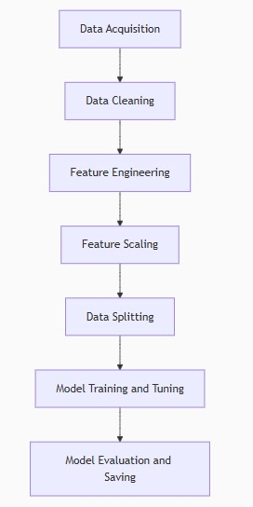
Methodology
Data Acquisition: Imported supply chain emission data from Excel files (2010–2016).
Data Cleaning: Removed unnecessary columns and handled missing or inconsistent values using Pandas.
Feature Engineering: Encoded categorical fields (like Substance, Unit, and Source) using LabelEncoder.
Feature Scaling: Standardized numerical features with StandardScaler.
Data Splitting: Split the dataset into training and testing sets using train_test_split.
Model Training and Tuning: Trained three models—Random Forest, Linear Regression, and Gradient Boosting. Tuned the Random Forest model using GridSearchCV.
Model Evaluation and Saving: Evaluated all models using RMSE and R² Score. Saved the best- performing model and scaler using joblib.

Slide 5
Problem Statement:
Supply Chain Emissions Modeling Using Industry and Commodity Data (2010–2016)
You have annual supply chain emission data from 2010–2016 categorized into industries and commodities. The goal is to develop a regression model that can predict the Supply Chain Emission Factors with Margins based on descriptive and quality metrics (substance, unit, reliability, temporal/geographical/technological/data collection correlations, etc.).

Slide 6

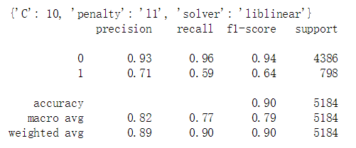
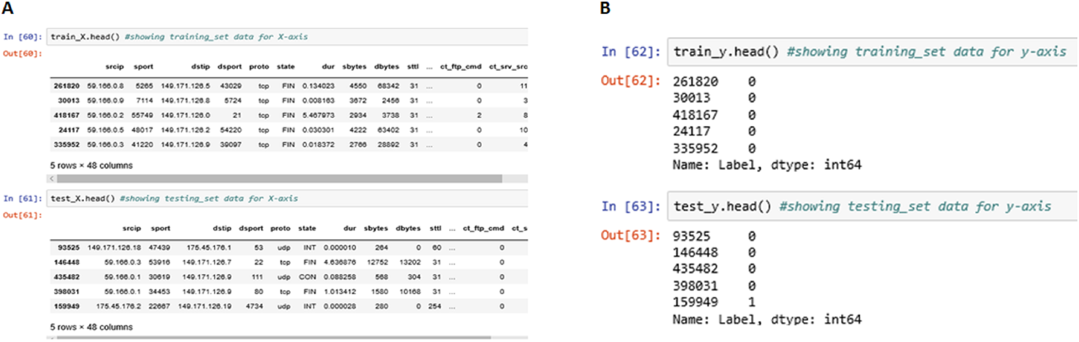
Solution:
Imported and merged Excel datasets from 2010 to 2016.
Cleaned and preprocessed the data, including handling null values and selecting relevant features.
Applied LabelEncoder to convert categorical features and used StandardScaler for normalization.
Split the dataset into training and testing sets.
Trained three regression models: Random Forest, Linear Regression, and Gradient Boosting.
Tuned the Random Forest model using GridSearchCV.
Evaluated models using RMSE and R² Score.
Saved the best-performing model and the scaler using joblib.
https://github.com/SalhaAfreen/EdunetFoundation-Shell-Greenhousegaspredictionproject

Slide 7
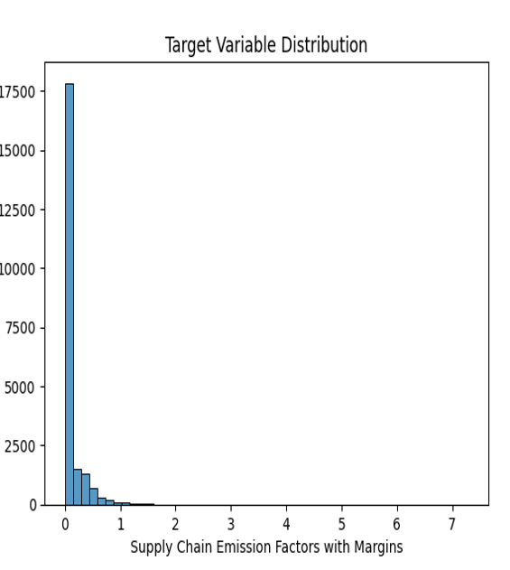
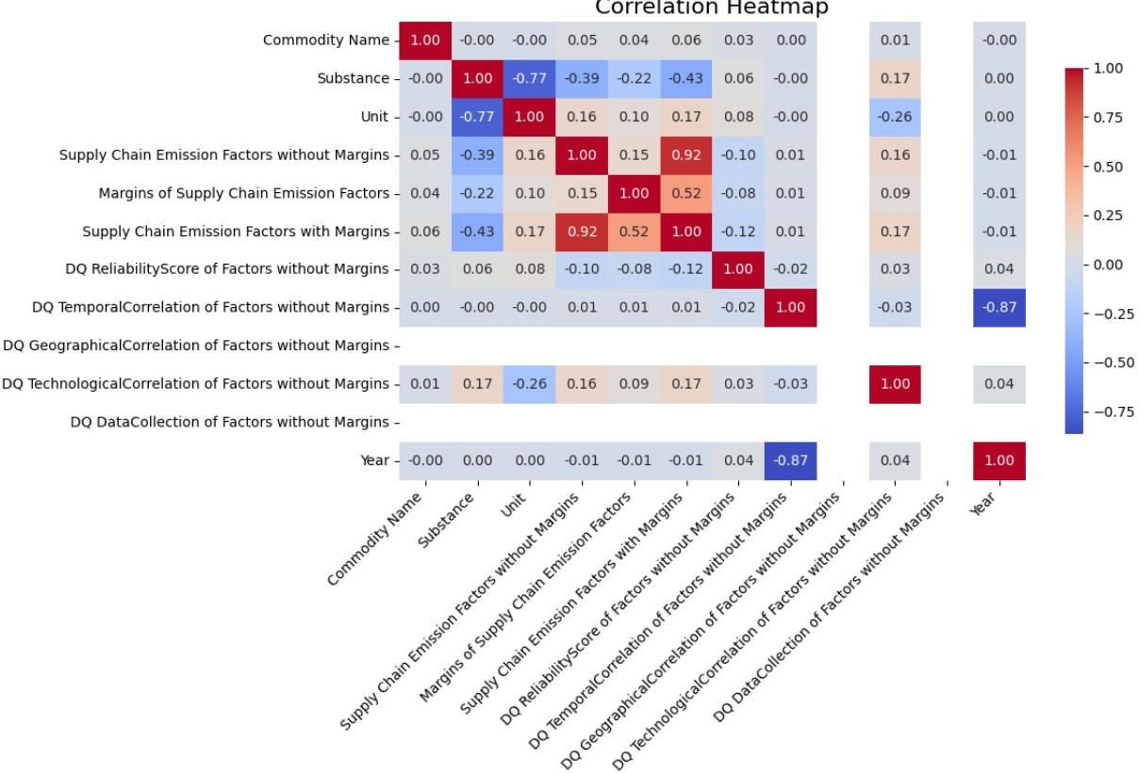
Screenshot of Output:

Slide 8
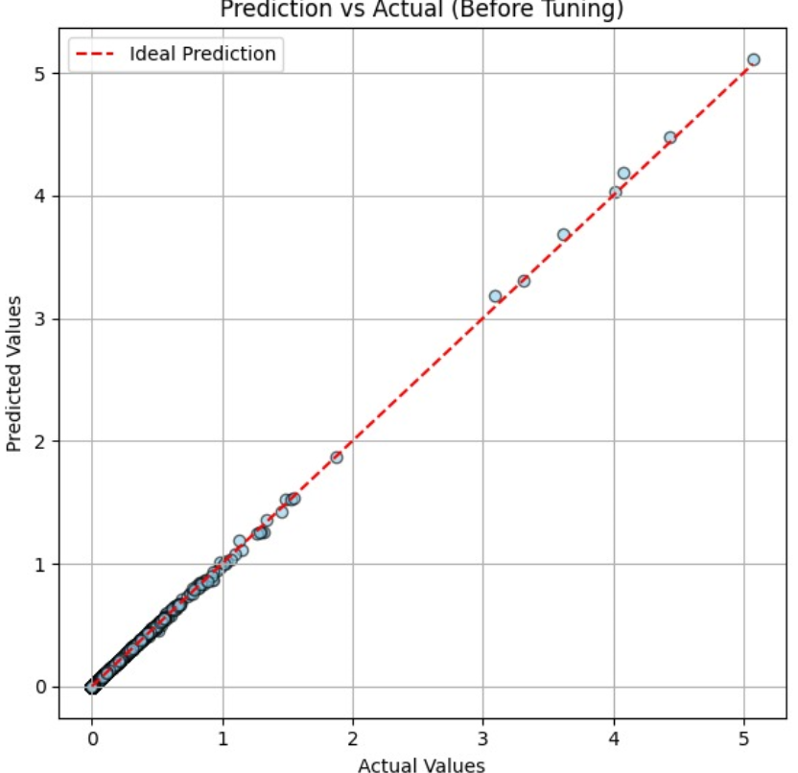
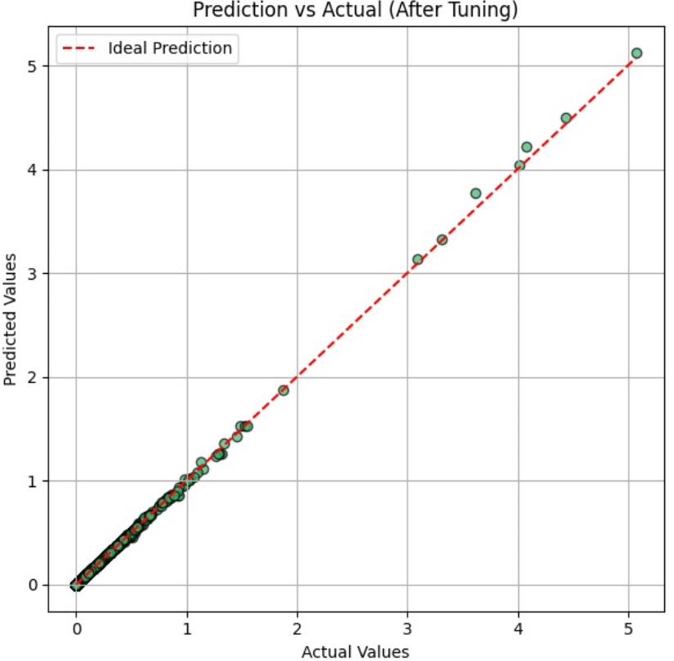
Screenshot of Output: Before and After Hyperparameter Tuning

Slide 9
Conclusion:
Successfully developed a regression-based machine learning model to predict Supply Chain Emission Factors.
Compared three models and achieved the best performance with the tuned Random Forest Regressor.
Feature importance analysis revealed key variables influencing emissions.
Emphasized the impact of scaling and categorical encoding on model performance.
The final model showed high R² and low RMSE, confirming its effectiveness.
Demonstrated how integrating domain knowledge with machine learning can lead to sustainable supply chain decisions.

